Slide 1
Employee Data Analysis using Excel
STUDENT NAME: MARY MERLIN.J
REGISTER NO:312212828(unm14512022g78)
DEPARTMENT:B .COM (general)
COLLEGE: Mahalashmi women's college of arts and sciences

Slide 2
PROJECT TITLE
Employee Performance Analysis using Excel

Slide 3


AGENDA
Problem Statement
Project Overview
End Users
Our Solution and Proposition
Dataset Description
Modelling Approach
Results and Discussion
Conclusion
3/21/2024 Annual Review

Slide 4

PROBLEM STATEMENT
Employee performance analysis is made to identify the performance level of an employee in each department
• Identify top performers and areas for improvement
•Evaluate team effectiveness and make data-driven decision

Slide 5

PROJECT OVERVIEW
.
•Develop and excel-based system to track , analyze and report employee performance metrics
•Improved employee performance tracking and analysis

Slide 6

WHO ARE THE END USERS?
✓HR Managers
✓Department Manager
✓Team leads
✓Marketing field
✓Banks

Slide 7

OUR SOLUTION AND ITS VALUE PROPOSITION
✓Conditional formatting
✓Filtering-removr
✓pivot table -summary
✓pie chart-data visualisation

Slide 8
Dataset Description
• Employee - kaggle
•26 features
• 9 features
•Employee id -number
•Name -text
•Employee type
•performance level
•Gender -male ,female
•Employee rating -number

Slide 9

THE "WOW" IN OUR SOLUTION
Performance level =IFS(Z8>=5,"VERY HIGH",Z8>=4,"HIGH",Z8>=3,"MED",TRUE,"LOW"
3/21/2024 Annual Review
9

Slide 10
MODELLING
Data Collection
Downloaded the data from edunet student’s dashboard.
Feature Collection
Highlighted data which is required using the fill option.
Data Cleaning:
Identified the missing values using conditional formatting.
Removed / Filtered the missing data using filter-filter by colour.
Performance level:
Performance Analysis is based on Department type is filtered by gender( Male employees)
10

Slide 11
Summary: Pivot table is created to summaries the data. Row labels- it is considered as department type. Column labels- describe the performance level. Filter – By gender where I perfered the male employees in this data. Values – To make a count used first name for count of employees in each field. Visualization: Used the graph chart to analyze the employees (in units) in the department type category. Used the Bar diagram to analyze the employees overall percentage in the department type category.

Slide 12
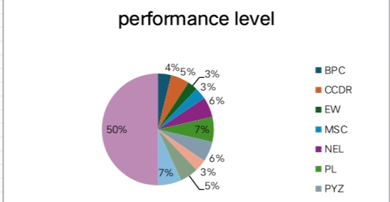
RESULTS
12

Slide 13
conclusion
• Therefore the production department employees performs higher comparing to other department and where as admin officer performs lower comparing to other department
• Hence the production department employees works more efficients and effectively comparing to other department

